Slide 1

Mini project
For the award of the degree of Master in Data Science and Applied Statistics
SUPERVISED BY:
Dr. Indrajeet Kumar Assistant Professor
SUBMITTED BY:
Rahul kumar Mahato
EnRoll No. CUSB2302222005
SEMESTER - III
[SESSION: 2023-2025]
𝕯𝖊𝖕𝖆𝖗𝖙𝖒𝖊𝖓𝖙 𝖔𝖋 𝕾𝖙𝖆𝖙𝖎𝖘𝖙𝖎𝖈𝖘
SCHOOL OF MATHEMATICS, STATISTICS AND COMPUTER SCIENCE
Central University of South Bihar , Gaya

Slide 2
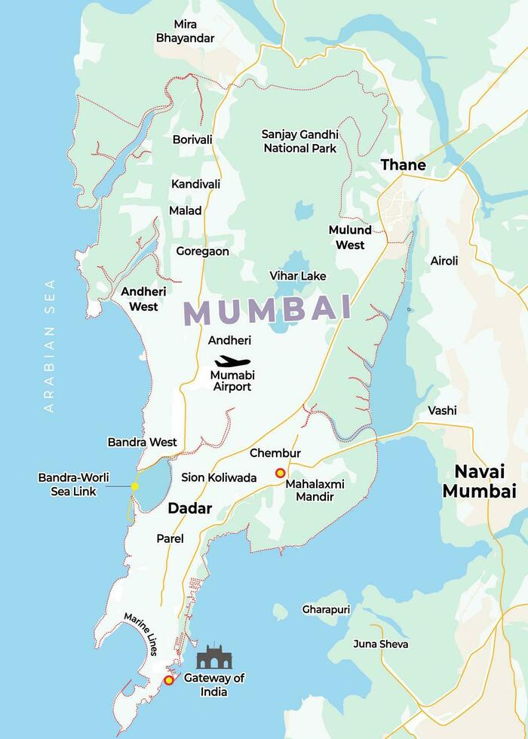
"Predicting Mumbai’s Air Quality Index : Leveraging Machine Learning for AQI Forecasting"
Project Title:

Slide 3
Objective
.
Mumbai faces ongoing air pollution challenges due to rapid urbanization, dense population, and industrial activity. The primary objective of this project is to analyze and predict the Air Quality Index (AQI) in Mumbai using machine learning algorithms and artificial neural networks (ANN).
.
Iterative approaches to corporate strategy
Establish a management framework from the inside
By identifying patterns in pollutant concentrations and weather data, this project aims to forecast Air Quality Index levels accurately and provide insights into reducing pollution in the city. This model will serve as a tool to inform policy decisions, enhance pollution control measures, and improve public health in Mumbai.

Slide 4
Mumbai, the financial capital of India, is not only a hub for commerce but also one of the most densely populated cities in the world. With an estimated population of 12.5 million and a rapidly expanding urban footprint, the city faces significant environmental challenges, particularly in managing air quality. Air pollution from vehicular emissions, industrial activities, and construction has continued to get worse despite several efforts to control it. Moreover, Mumbai has one of the busiest airports in India, attracting millions of tourists from both within the country and across the globe. Poor air quality can create a negative impression on visitors and impact the quality of life for residents. With the advent of advanced data science, this project proposes to utilize machine learning techniques to predict AQI in Mumbai. By leveraging data science, we can harness the power of predictive analytics to make the world a better place—starting with improving Mumbai's air quality. Predicting future AQI will help in early intervention, more effective pollution control, and better public health measures.
MOTIVATION:

Slide 5
The Dataset is sourced from the Central Pollution Control Board (CPCB), a government-managed institution that provides reliable and consistent data on air quality across India. The dataset includes various air pollutant and meteorological variables. Key variables include: PM2.5 & PM10 (µg/m³): Fine and coarse particulate matter, the primary pollutants in urban areas. NO2 (µg/m³): Nitrogen dioxide, linked to vehicular emissions. SO2 (µg/m³): Sulfur dioxide, an indicator of industrial emissions. CO (mg/m³): Carbon monoxide, produced from incomplete combustion of fuel. Ozone (µg/m³): Ground-level ozone, harmful to respiratory health. AT (°C), RH (%), WS (m/s), WD (deg): Meteorological features like air temperature, relative humidity, wind speed, and wind direction that affect pollutant dispersion. These variables provide a comprehensive overview of air quality in Mumbai, helping the model to forecast AQI effectively.
Data Description:

Slide 6




Methodology The project will involve the following steps
Data Preprocessing
Model Development
Model Evaluation &
Feature Importance
Model Deployment
0 - 14 days
14 - 35 days
60 days – 80 days
35 days – 60 days

Slide 7






Data preprocessing steps:
Data Cleaning
Remove or fill in missing or inconsistent data points to ensure the dataset is complete and ready for analysis.
Feature Selection
Normalization
Identify the most important variables (e.g., pollutants like PM2.5, PM10, and weather conditions) that contribute to AQI prediction, and remove less relevant features.
Scale the data so that all features have comparable ranges, improving the performance of machine learning algorithms.
Handling Outliers
Train-Test Split
Detect and address extreme values (outliers) that could distort the model’s learning process.
Divide the dataset into training and testing sets to evaluate the model’s performance on unseen data.
Data Transformation
Apply techniques like encoding categorical variables or creating new features from existing ones to enhance the dataset's usability and relevance for the model.

Slide 8
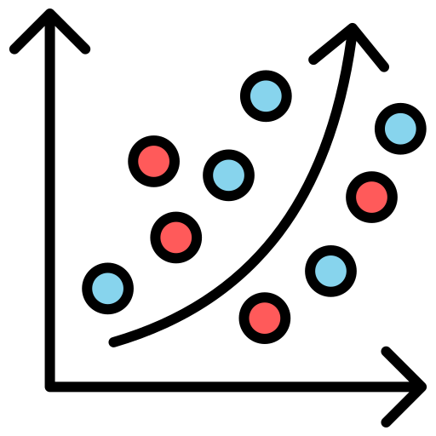





Model Devlopment:
Linear Regression: Builds a model to predict AQI based on a linear relationship between predictor variables and the target variable.
LASSO Regression: Enhances linear regression by adding a penalty for large coefficients to prevent overfitting and improve model generalization.
Decision Tree Regressor: Creates a model that splits data into subsets based on feature values, making predictions based on the majority class or average outcome in each subset.
KNN Regressor: Predicts AQI by averaging the values of the nearest neighbors in the feature space, providing a non-parametric approach to modeling.
Random Forest Regressor: Combines multiple decision trees to improve prediction accuracy and reduce overfitting by averaging their results.

Slide 9




Model Devlopment:
XGBoost Regressor: Utilizes gradient boosting to build a series of models that correct the errors of previous ones, often yielding high performance in predictions.
Hyperparameter Tuning: Optimizes model parameters (e.g., tree depth, learning rate) to enhance performance and accuracy.
Artificial Neural Network (ANN): Constructs a neural network with multiple layers to capture complex patterns and relationships in the data, improving predictive capability.
Each model and technique contributes differently to improving AQI prediction accuracy and understanding the factors influencing air quality.

Slide 10
Model Evaluation & Feature Importance Model Evaluation & Freature selection will involve the following steps
Mean Absolute Error (MAE)
Mean Squared Error (MSE)
R-squared
Identifying Key Variables & Ranking Features
Measures the average magnitude of errors in predictions, providing an easy-to-understand metric of model accuracy.
Assesses the average squared difference between predicted and actual values, highlighting larger errors more significantly.
Indicates the proportion of variance in the dependent variable that is predictable from the independent variables, showing how well the model fits the data.
Understanding Evaluates which features (e.g., pollutants, weather conditions) have the most significant impact on AQI prediction.

Slide 11







Tools:
To successfully implement the project, the following tools and libraries will be used:
Programming Language: Python
Data Handling: Pandas , NumPy
Data Visualization:
Machine Learning Libraries: Scikit-learn , XGBoost , for ANN
Model Evaluation: Scikit-learn, Hyperopt (for tuning)
Data Source: Central Pollution Control Board (CPCB)

Slide 12
Results and Conclusion:
The expected outcome of the project is the development of a robust AQI prediction model that can forecast future air quality levels in Mumbai. The model will provide actionable insights on the severity of pollution in various regions and identify which pollutants are contributing most to air quality degradation. This tool will help policymakers, urban planners, and the Brihanmumbai Municipal Corporation (BMC) to take data-driven decisions for pollution control.
Additionally, by comparing various machine learning algorithms and ANN, we can determine the most effective model for AQI prediction. The integration of hyperparameter tuning will ensure that the chosen model is optimally designed for maximum accuracy.
In conclusion, this project aims to provide a valuable contribution to improving Mumbai’s air quality management using data science and advanced predictive modeling techniques. By understanding the air pollution dynamics and taking early action, the project aspires to create a healthier, more sustainable urban environment for the residents of Mumbai.

